Slide 1
Example presentation
22 January 2023

Slide 2
EXAMPLE - Slide with charts and automatic text

Slide 3
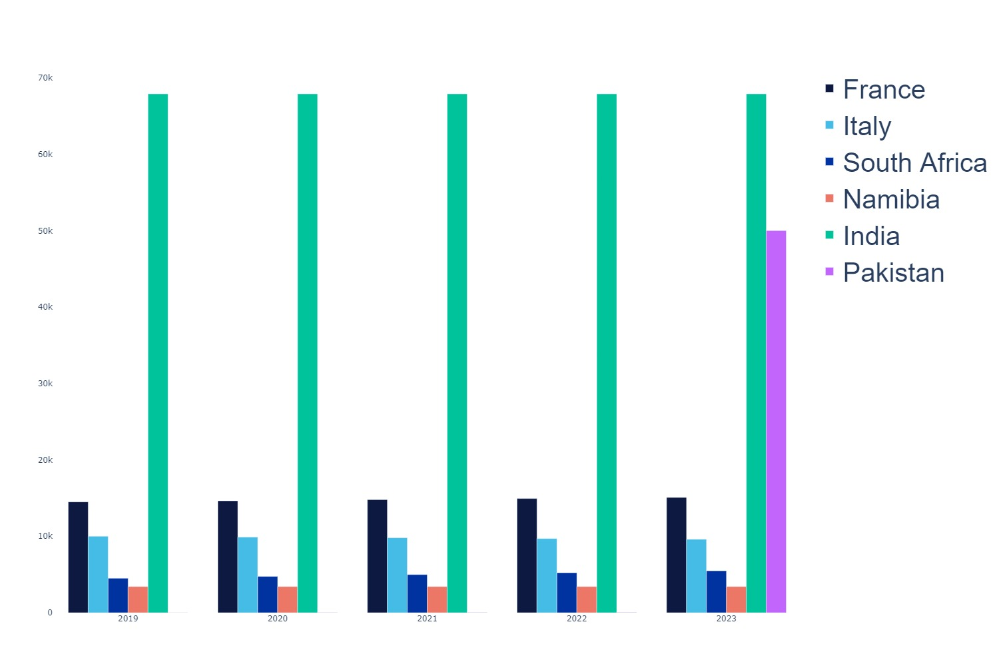
EXAMPLE - Slide with charts and automatic text
Between 2019 and 2023, there was an increase of 4.06 % in sales in France. This represents a change of 588.0 units.
Between 2019 and 2023, there was an decrease of -3.95 % in sales in Italy. This represents a change of -395.0 units.
Between 2019 and 2023, there was an increase of 21.82 % in sales in South Africa. This represents a change of 982.0 units.
Between 2019 and 2023, there was no significant change in sales in Namibia.
Between 2019 and 2023, there was no significant change in sales in India.
Between 2019 and 2023, there was an increase of 499900.0 % in sales in Pakistan. This represents a change of 49990.0 units.

Slide 4
EXAMPLE - Slide with table

Slide 5
EXAMPLE - Slide with table
sales | continent | 2019 | 2020 | 2021 | 2022 | 2023
France | Europe | 14500 | 14645 | 14791.0 | 14939.0 | 15088.0
Italy | Europe | 10000 | 9900 | 9801.0 | 9702.0 | 9605.0
South Africa | Africa | 4500 | 4745 | 4990.0 | 5236.0 | 5482.0
Namibia | Africa | 3420 | 3420 | 3420.0 | 3420.0 | 3420.0
India | Asia | 67895 | 67895 | 67895.0 | 67895.0 | 67895.0
Pakistan | Asia | 10 | 20 | 30.0 | 40.0 | 50000.0

Slide 6
EXAMPLE - Slides with maps

Slide 7
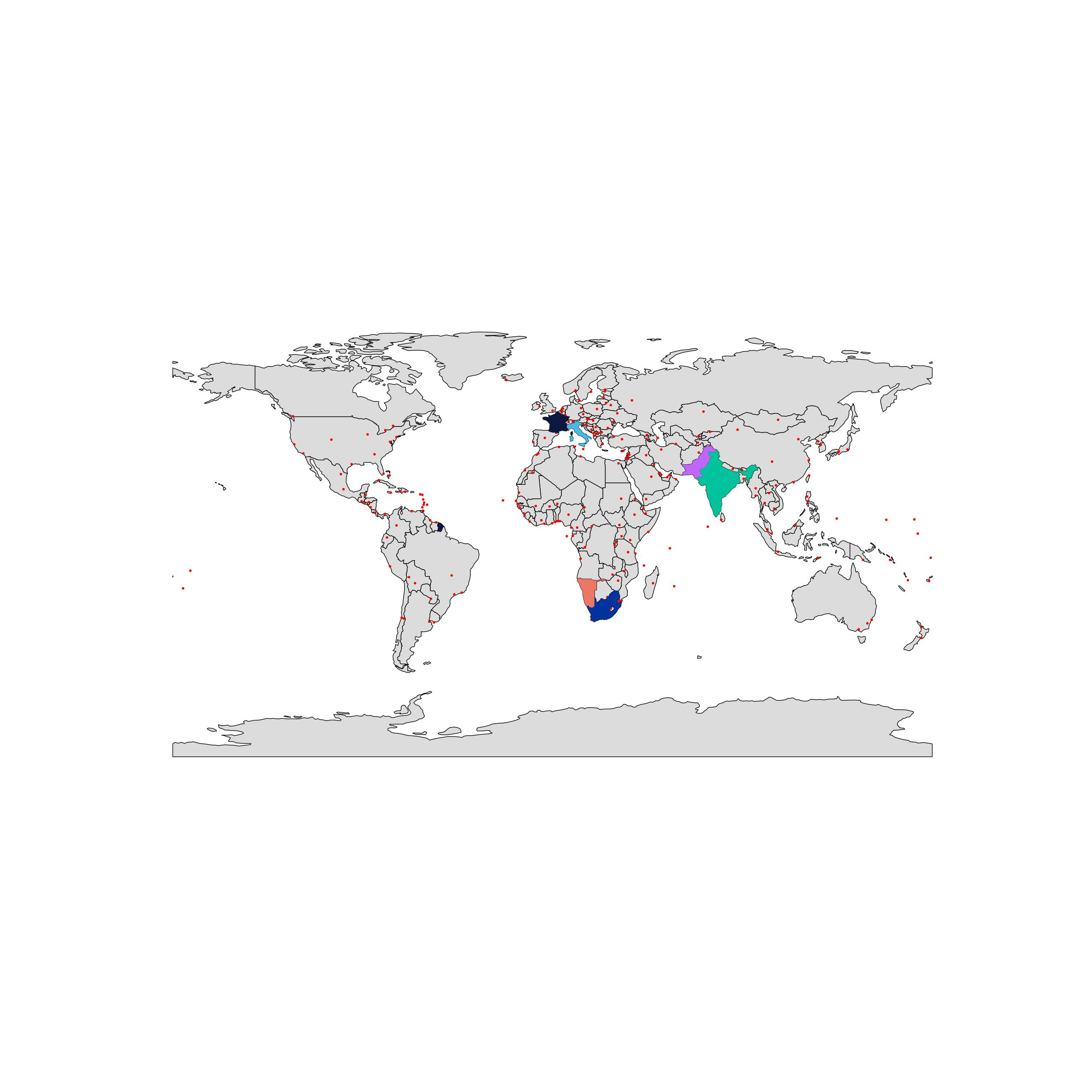
EXAMPLE - Slide with world map
The countries highlighted are France, Italy, South Africa, Namibia, India and Pakistan.

Slide 8
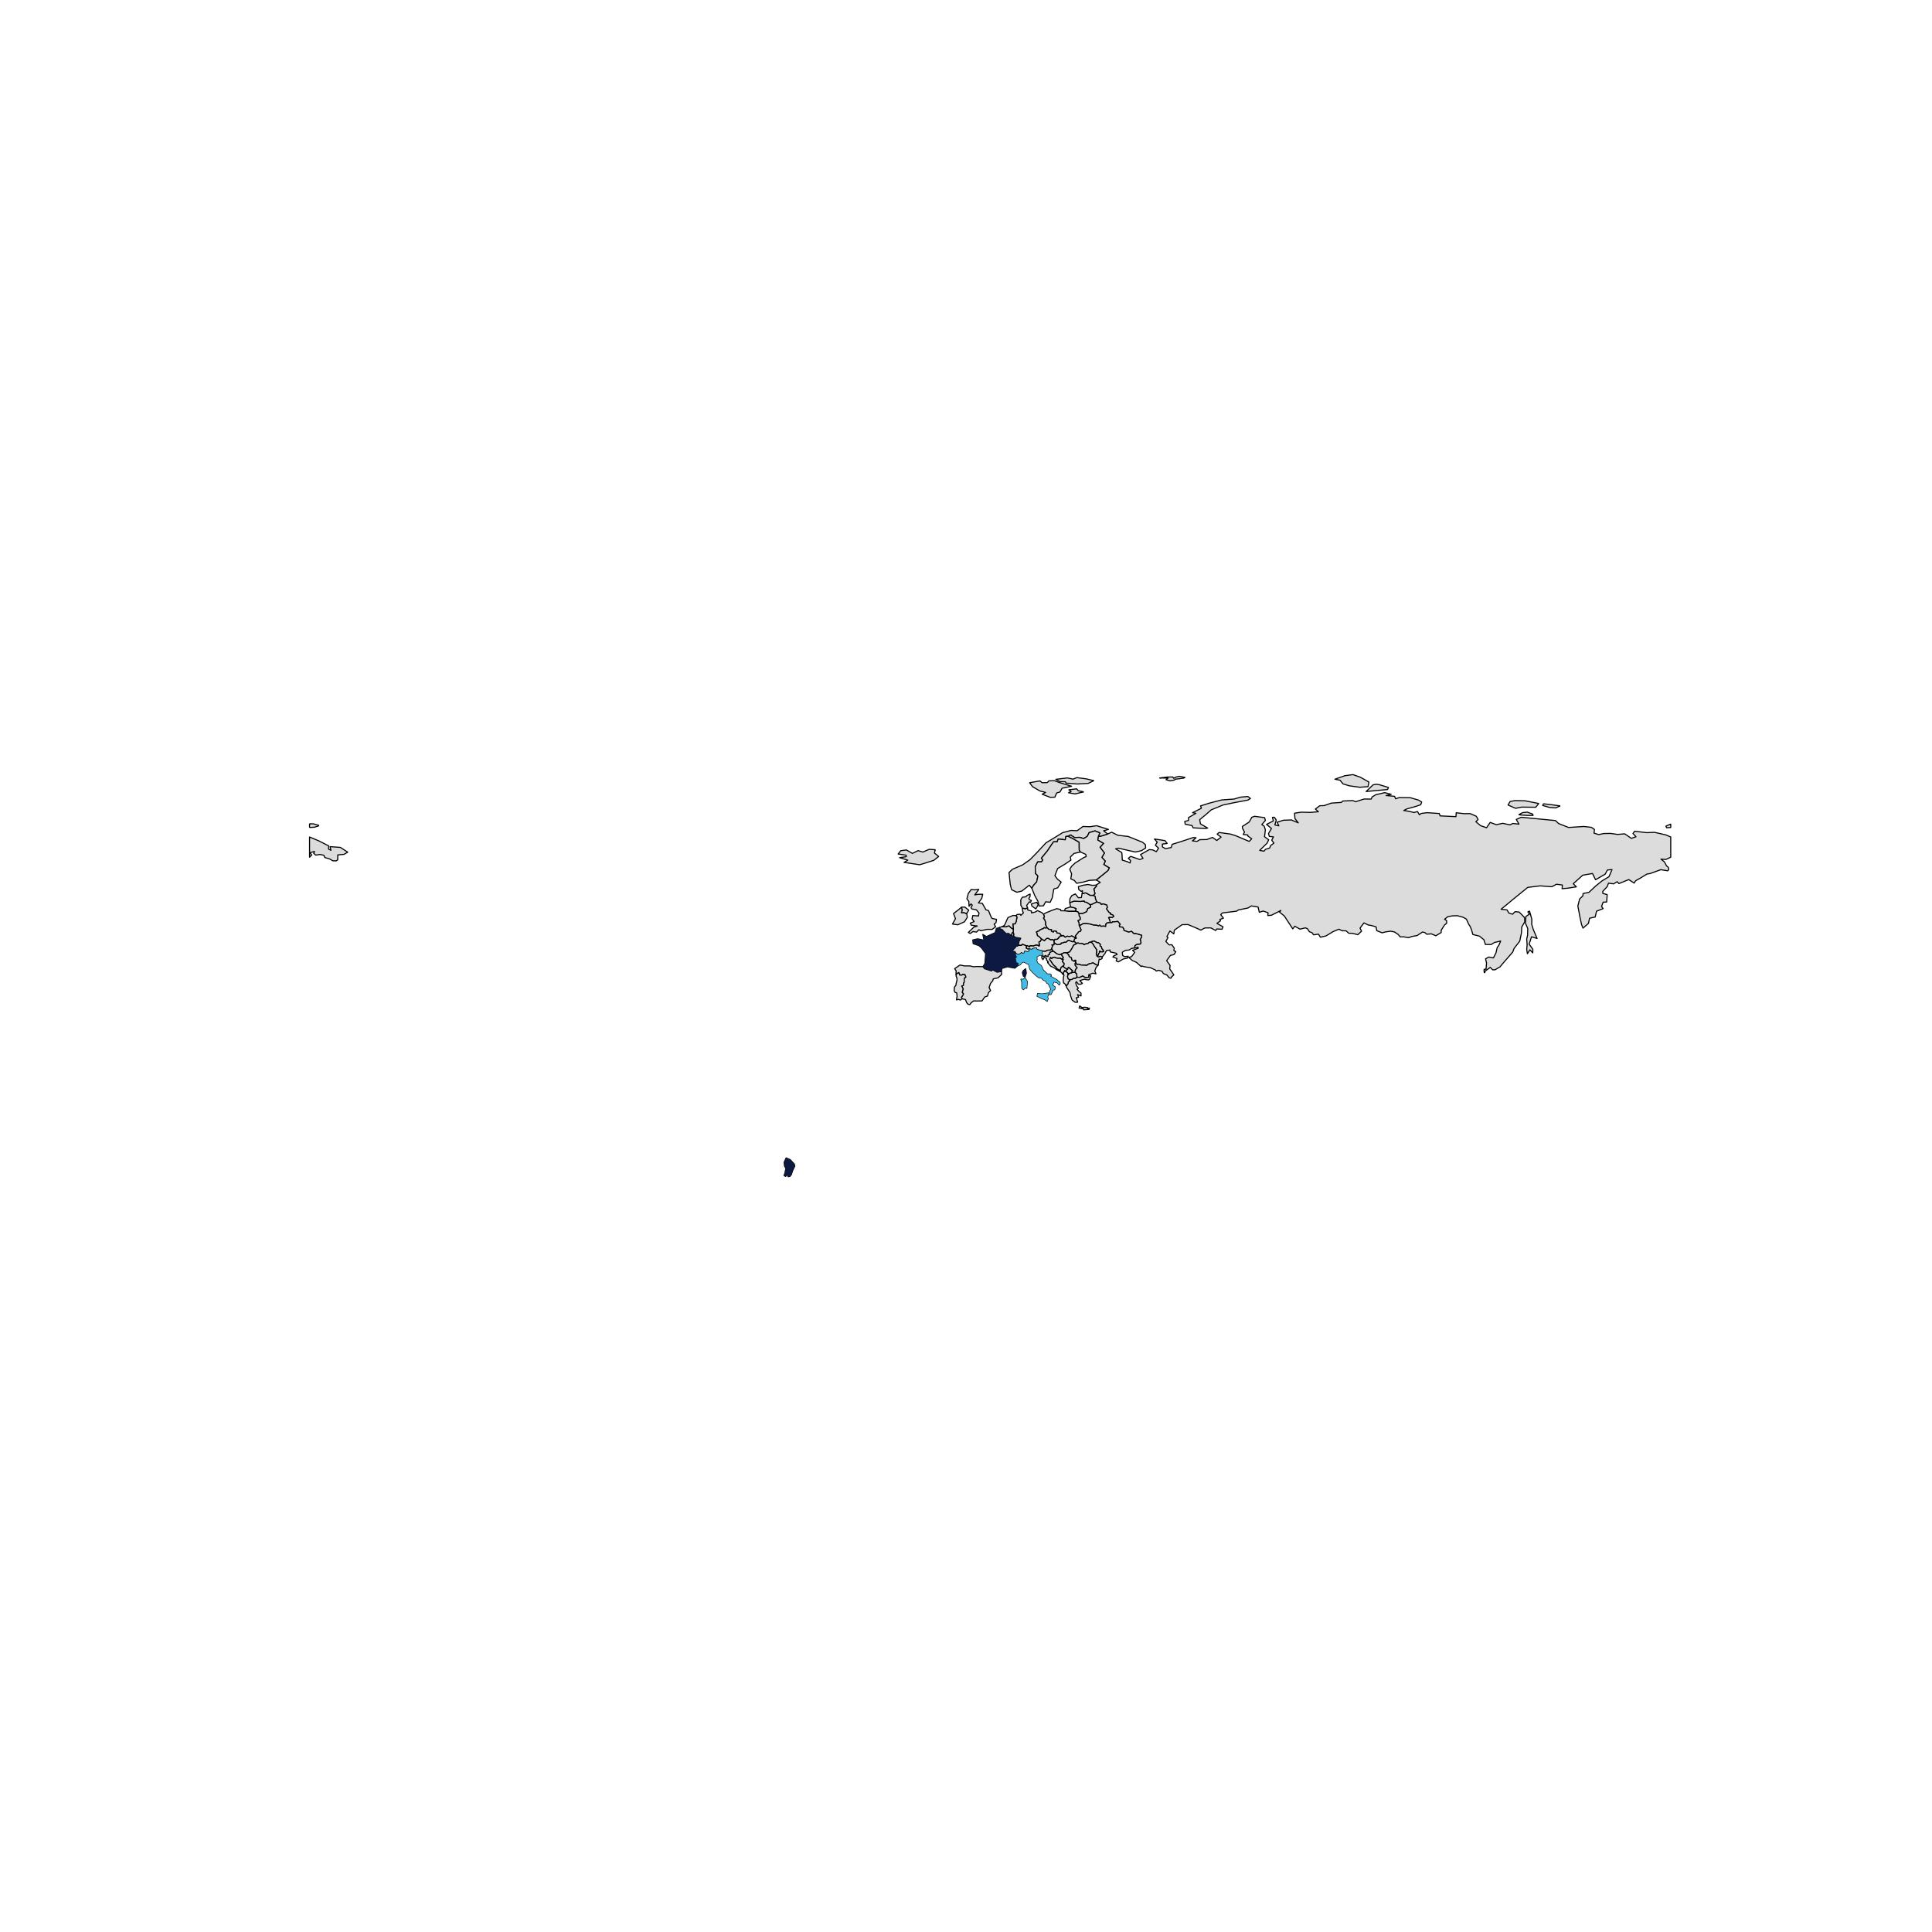
EXAMPLE - Slide with Europe map
The countries highligted are France and Italy.

Slide 9
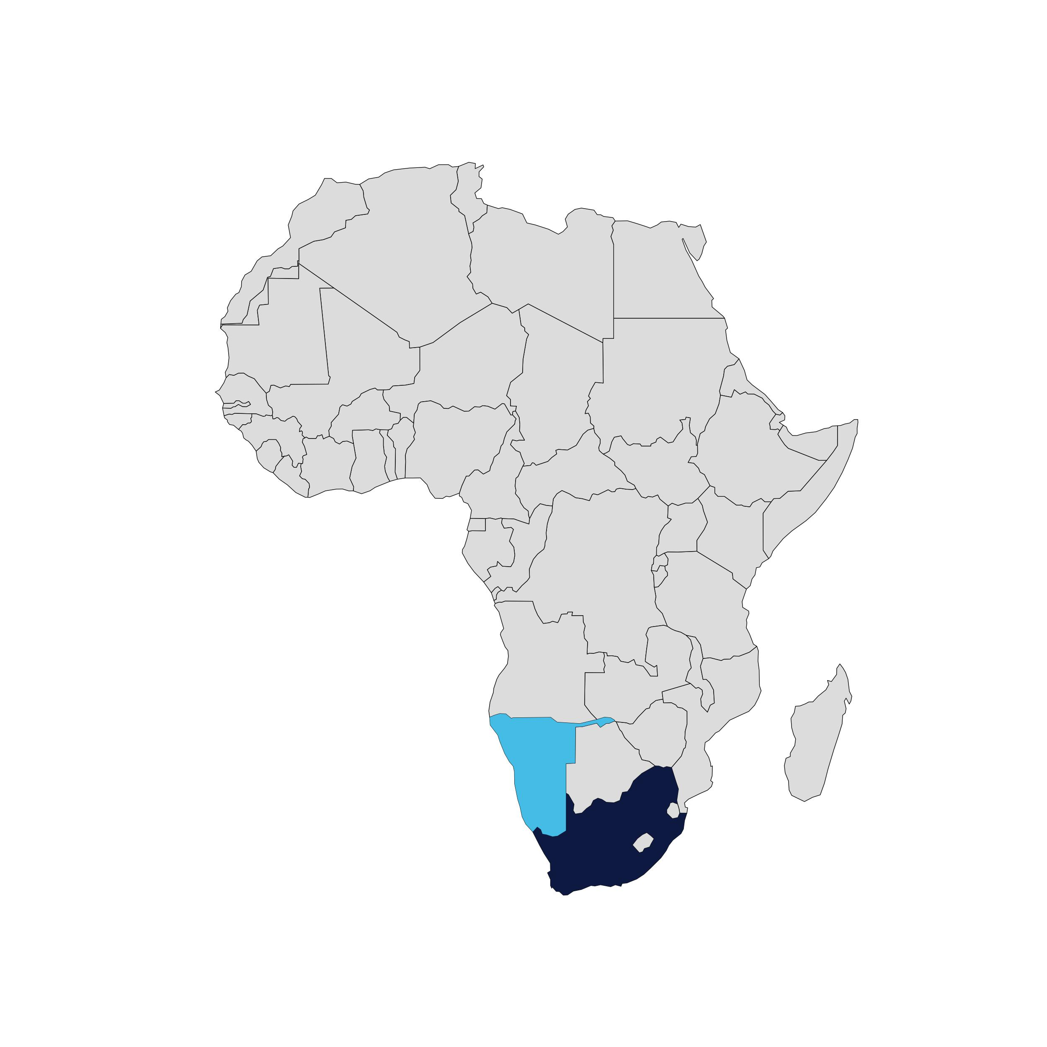
EXAMPLE - Slide with Africa map
The countries highligted are South Africa and Namibia.

Slide 10
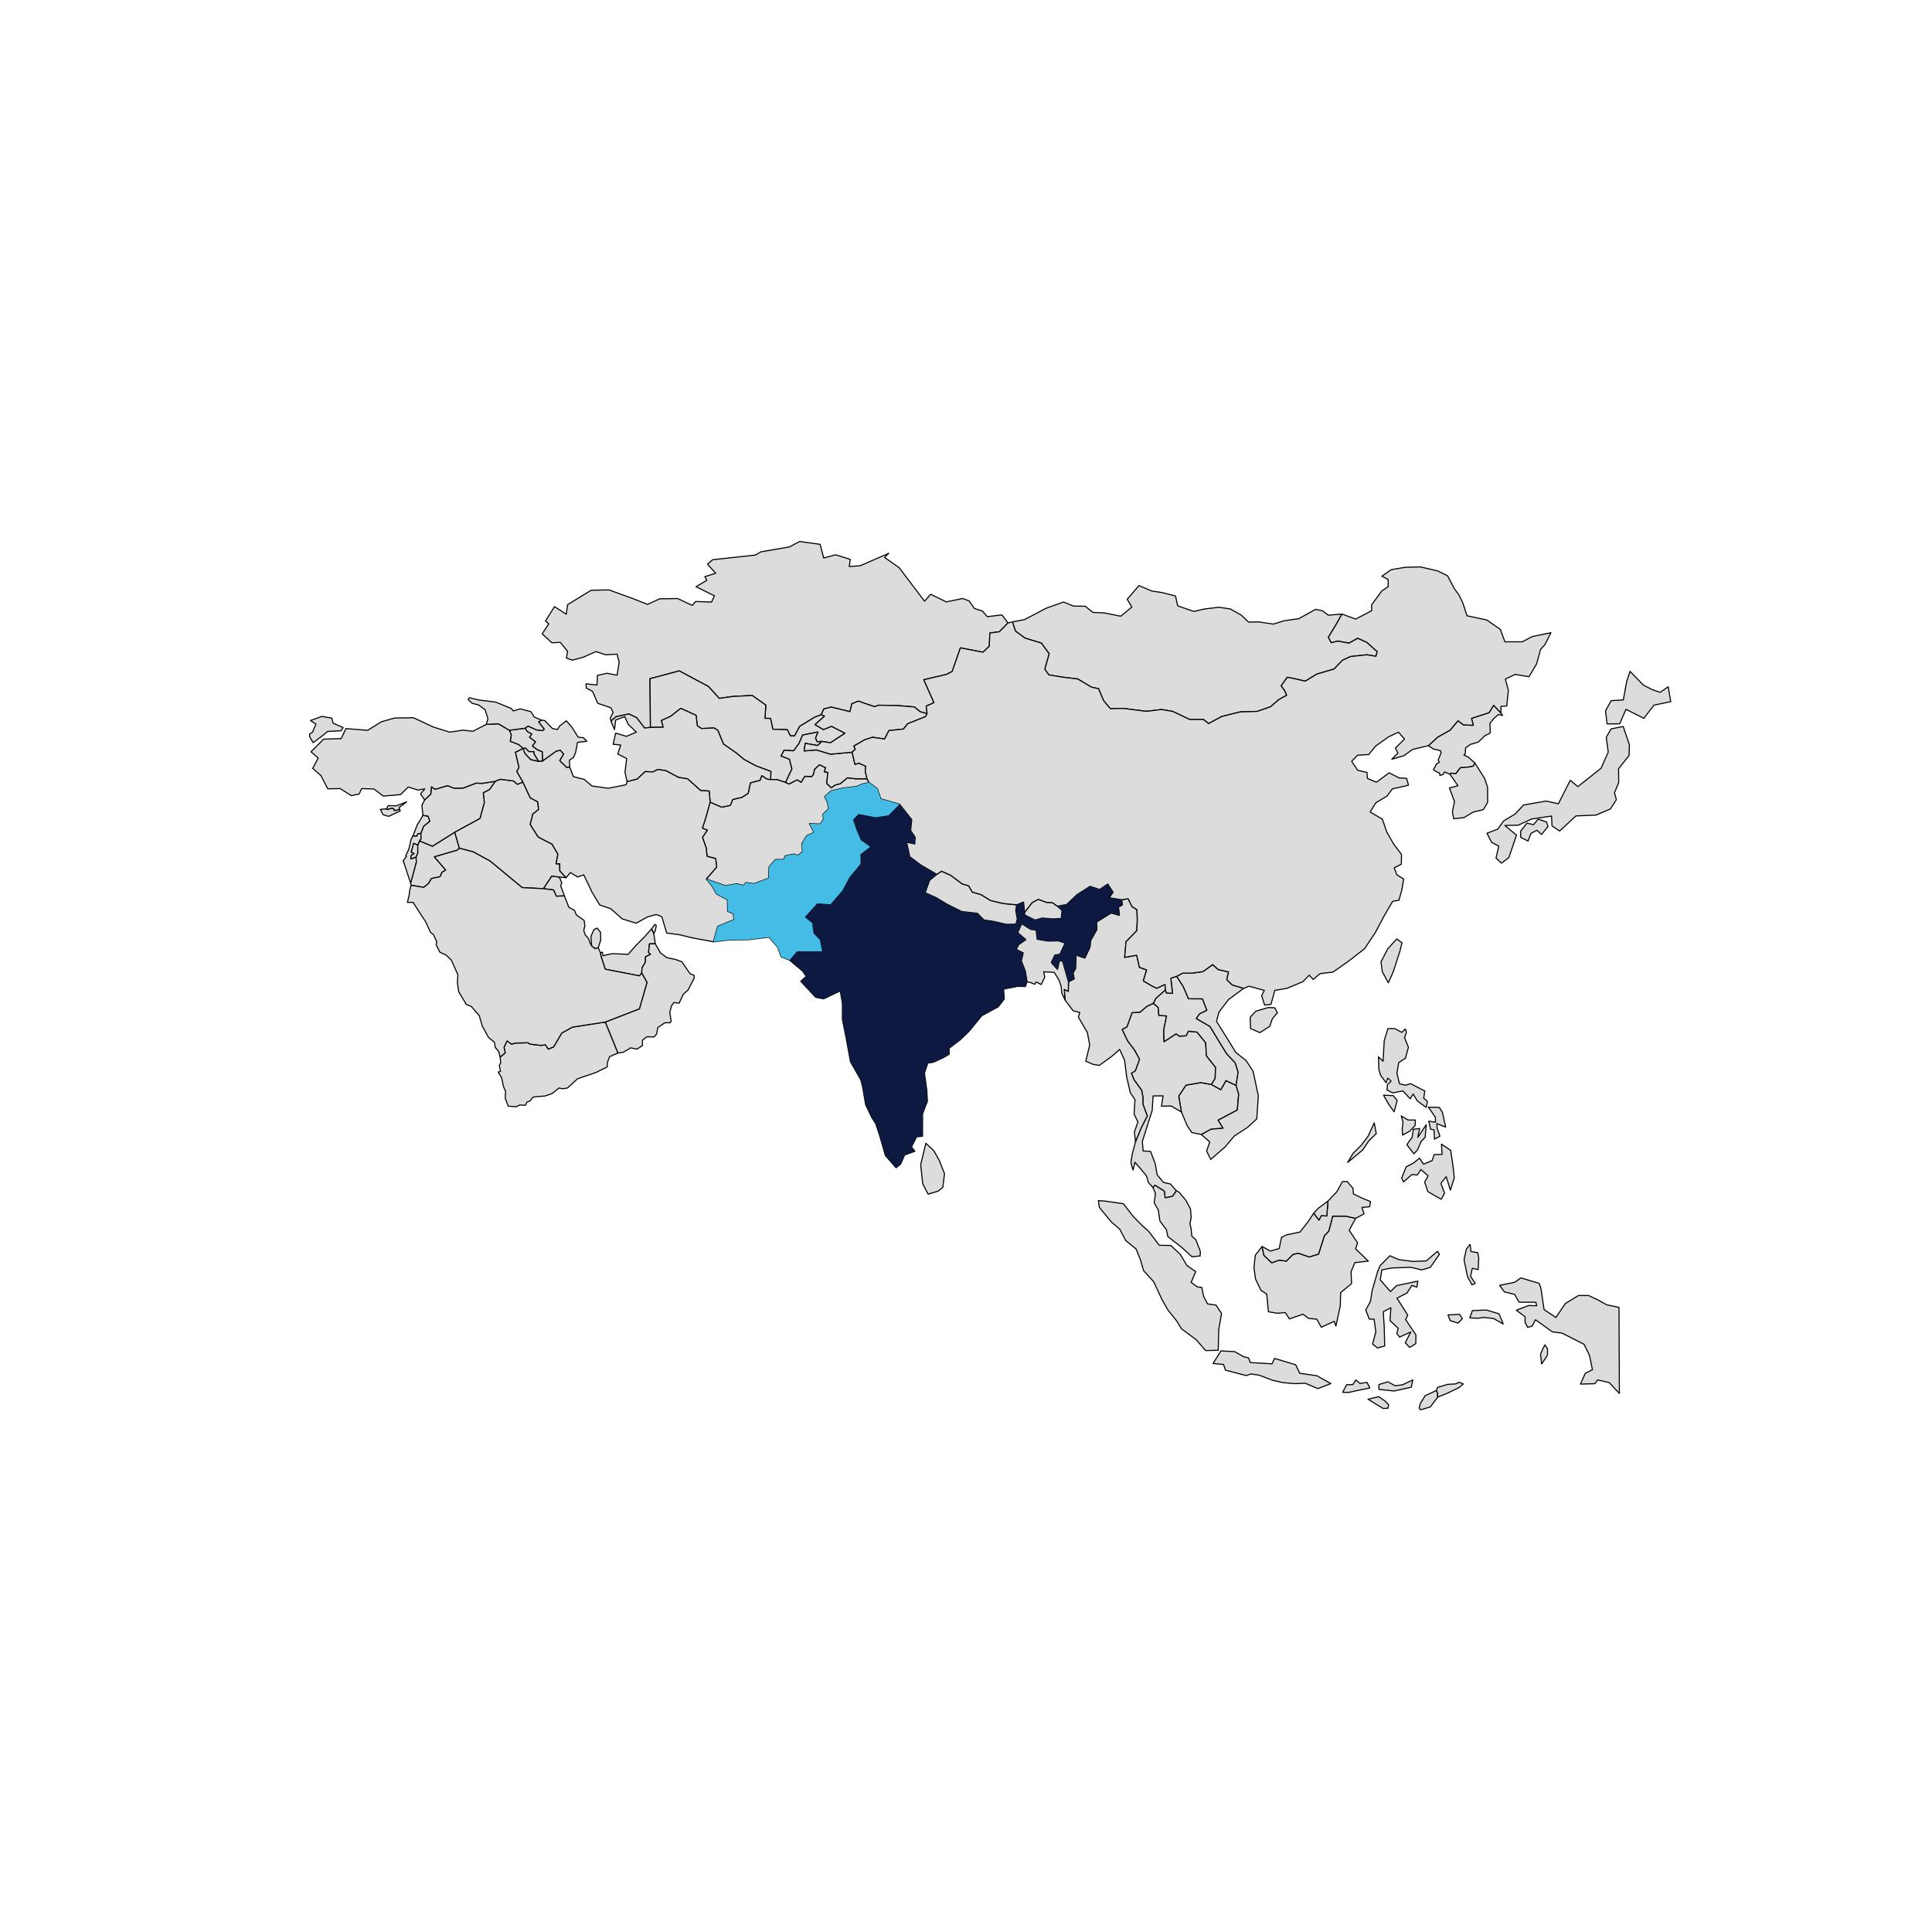
EXAMPLE - Slide with Asia map
The countries highligted are India and Pakistan.

